Slide 1
Education Board Information System
Prepared By:
Akib An Noor
2013-1-60-056

Slide 2
Contents:
Users
Motivation of this program(How it works)
Class diagram
Functional diagram

Slide 3
Who are the users ?
General Users
Board Admins
Regular Students

Slide 4
i. General Users
View the board exam information by own choice.
ii. Board Admins
Publish any student’s result.
iii. Regular Students
Search for exam result.

Slide 5
Class diagram :
Student
Public:
char q[20], s_name[15], s_id[10], b_name[10];
int e_year, b_code, w, s, s2, s3, s4, s5;
Public:
void showboard();
float showgrade();
void calculate();
void show_result();
void dhk_b();
void bar_b();
void raj_b();
void chi_b();
void syl_b();
void jess_b();
void din_b();
void com_b();

Slide 6
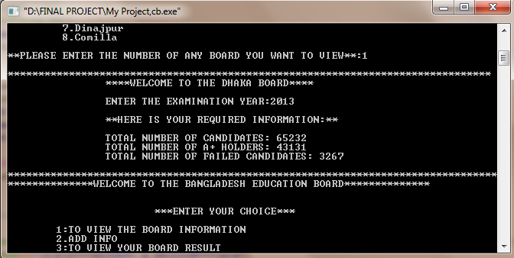
Motivation (how it works):
can choose any board to view the information.

Slide 7
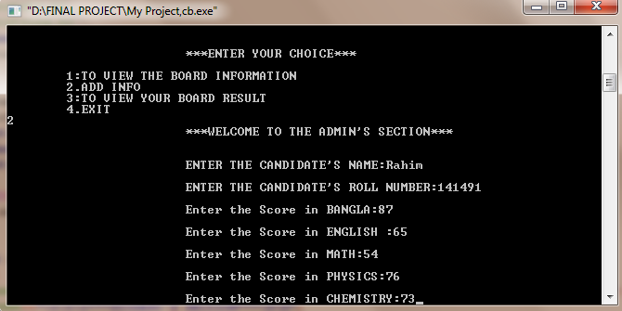
Can publish any student’s result.

Slide 8
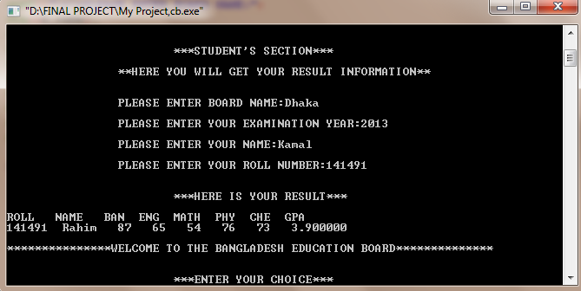
Can search for result.

Slide 9
START
Enter your choice
Case 2:
Add any Student Info (For Admin use only)
Case 3:
Search for board exam result
Case 1:
View any board information

Slide 10
Select the board you want to view
Add any student’s board exam information
Enter your info to search your result
You Will get your necessary information
You will get your exam result
STOP

Slide 11

THANKS FOR WATCHING

